Slide 1
Data Drive Fracture Mechanics: Discovering Elastic Constants and Failure Criteria using PINNs
Thomas Allard
Samantha Walker
April 26, 2022

Slide 2
Outline
Background – Fracture Mechanics
Input Data – Abaqus Simulations
Background – PINNs
Elastic PINN
Fracture PINN
Conclusions
References

Slide 3
Background
Stress intensity factor → energy release rate
Displacement control is stable for brittle crack propagation

Slide 4
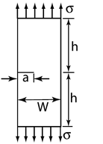
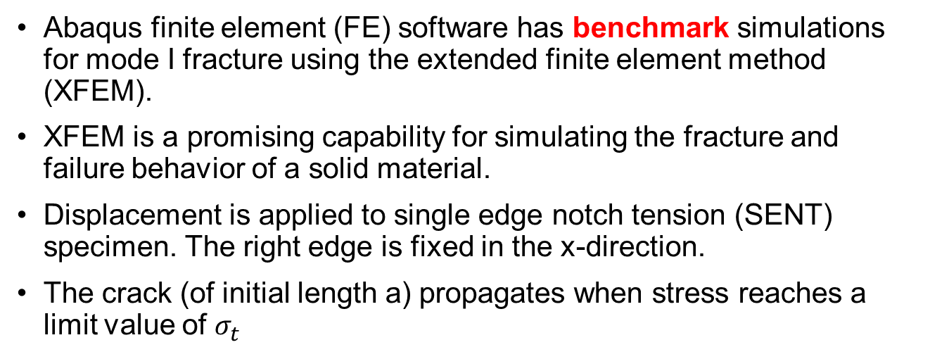
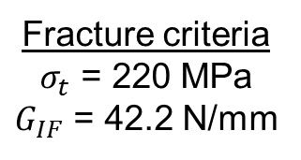
Input Data – Abaqus Simulations
u
Abaqus finite element (FE) software has benchmark simulations for mode I fracture using the extended finite element method (XFEM).
XFEM is a promising capability for simulating the fracture and failure behavior of a solid material.
Displacement is applied to single edge notch tension (SENT) specimen. The right edge is fixed in the x-direction.
The crack (of initial length a) propagates when stress reaches a limit value of $σ_{t}$
a = 300 mm
h = 1500 mm
W = 3000 mm
u = 1 mm
Elastic Modulus
Elastic parameters
E = 210 GPa
ν = 0.3
Fracture criteria
$σ_{t}$ = 220 MPa
$G_{IF}$ = 42.2 N/mm
Max tensile stress
u
Mode I fracture energy release rate
Poisson’s Ratio

Slide 5
Input Data – Abaqus Fracture
a = 300 mm
h = 1500 mm
W = 3000 mm
u = 1 mm

Slide 6
Input Data – Abaqus Elastic
a = 300 mm
h = 1500 mm
W = 3000 mm
u = 1 mm

Slide 7
Background - PINNs
General – borrow from old slides
Sciann
Why??? Lol Yang *shrugs* → they actually have great examples! We used
https://github.com/sciann/sciann-applications
Data – (maybe move to end of Abaqus discussion)
Abaqus output database (ODB) extraction
Used xarray data formats (DataSets and DataArrays) to conveniently store and call simulation data, netcdf file
Hyperparameters
Started from sciann-applications
Tested different normalizations

Slide 8
Elastic PINN
Some outputs and plots
Troubles! ☹

Slide 9
Fracture PINN
Technically no trouble! (cuz we didn’t get here yet lol)
Ambitious goals

Slide 10
Conclusions
Why NNs so hard ☹

Slide 11
References

